Slide 1

Department of Computer Science and Engineering
M. S. Ramaiah Institute of Technology
(Autonomous Institute, Affiliated to VTU)
Distributed Systems
CSE751
Introduction: Definition, Relation to computer system components, Motivation, Primitives for distributed communication, Synchronous versus asynchronous executions, Design issues and challenges.
A model of distributed computations: A distributed program, A model of distributed executions, Models of communication networks, Global state of a distributed system, Cuts of a distributed computation, Past and future cones of an event.
Logical time: Introduction, A framework for a system of logical clocks, Scalar time, Vector time, efficient implementations of vector clocks, Jard–Jourdan’s adaptive technique. Relation to parallel multiprocessor/multicomputer systems, Message-passing systems versus shared memory systems.

Slide 2
Lesile Lamport
Leslie B. Lamport is an American computer scientist. Lamport is best known for his seminal work in distributed systems, and as the initial developer of the document preparation system LaTeX and the author of its first manual.
“A distributed system is one in which the failure of a computer you didn’t even know existed can render your own computer unuasble”.

Slide 3
Why to design a system as a distributed system?
Societal Importance
Challenging: Node failures, Concurrency
Eg: PASS developed by IBM in 1981 used in space shuttle.
Failure of one node does not lead to the failure of the entire distributed system. Other nodes can still communicate with each other.
An important goal of a distributed system is to make it easy for users (and applications) to access and share remote resources. Resources can be virtually anything.

Slide 4
Advantages of Distributed Systems
All the nodes in the distributed system are connected to each other.
More nodes can easily be added to the distributed system i.e. it can be scaled as required.
Failure of one node does not lead to the failure of the entire distributed system.
Resources like printers can be shared with multiple nodes rather than being restricted to just one.
A distributed system enables you to do is scale horizontally.
Scaling horizontally simply means adding more computers rather than upgrading the hardware of a single one.

Slide 5
Disadvantages of Distributed Systems
It is difficult to provide adequate security in distributed systems because the nodes as well as the connections need to be secured.
Some messages and data can be lost in the network while moving from one node to another.
The database connected to the distributed systems is quite complicated and difficult to handle as compared to a single user system.
Overloading may occur in the network if all the nodes of the distributed system try to send data at once.

Slide 6
Distributed Systems
A distributed system is a system whose components are located on different networked computers, which communicate and coordinate their actions by passing messages to one another.
Distributed systems allow breaking complex problems/data into smaller pieces and have multiple computers work on them in parallel, which can help cut down on the time needed to solve/compute those problems.

Slide 7
Introduction
A distributed system is a collection of independent entities that cooperate to solve a problem that cannot be individually solved ex: From a school of fish to a flock, of birds and entire ecosystems of microorganisms
Distributed computing systems as a useful and widely deployed tool is becoming a reality.
A distributed system has been characterized in one of several ways:
one when the crash of a computer you have never heard
A collection of computers that do not share common memory or a common physical clock, that communicate by a messages passing over a communication network, and where each computer has its own memory and runs its Own operating system. Typically the computers are semi-autonomous and are loosely coupled while they cooperate to address a problem collectively
A collection of independent computers that appears to the users of the system as a single coherent computer
A term that describes a wide range of computers
from weakly coupled systems such as wide-area networks
to strongly coupled systems such as local area networks
to very strongly coupled systems such as multiprocessor systems
Some features
No common physical clock ( speed,processor)
No shared memory (message passing, abstraction for common addresses)
Geographical separation(now “ low cost high speed”)
Autonomy and heterogeneity (speed, not dedicated, solve)

Slide 8
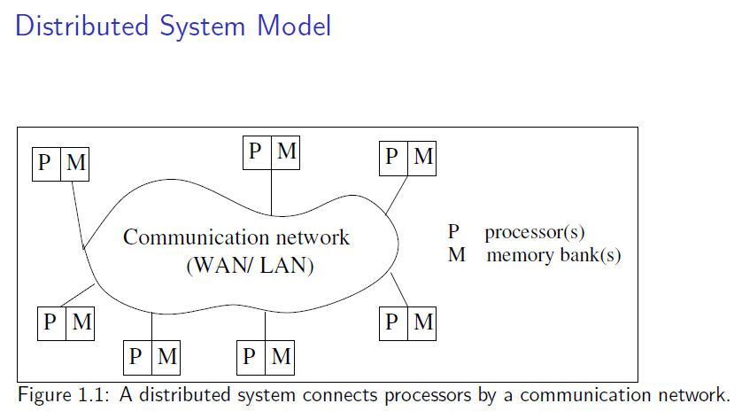

Relation to computer system components
Autonomous,middleware,distributed execution,computation,run

Slide 9
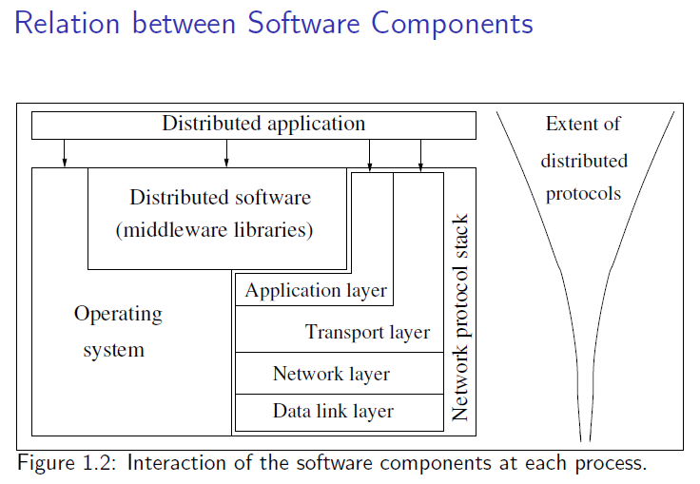
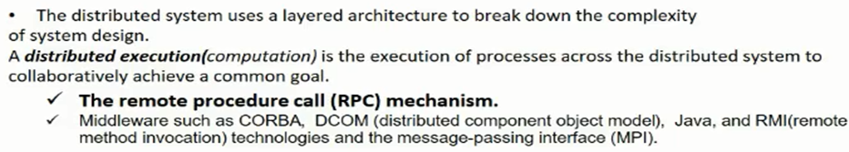
Notes:
Interaction, middleware-no application layer(http,mail), librarys-primitives and function calls, OMG,corba,RPC-lpc,send msg and wait, commercial dcom

Slide 10
1.3 Motivation
1. Inherently distributed computations In many applications such as money transfer in banking, or reaching consensus among parties that are geographically distant, the computation is inherently distributed.
2. Resource sharing Resources such as peripherals, complete data sets in databases, special libraries, as well as data (variable/files) cannot be fully replicated at all the sites because it is often neither practical nor cost-effective
3. Access to geographically remote data and resources In many scenarios, the data cannot be replicated at every site participating in the distributed execution because it may be too large or too sensitive to be replicated.
4. Enhanced reliability A distributed system has the inherent potential to provide increased reliability because of the possibility of replicating resources and executions, as well as the reality that geographically distributed resources are not likely to crash/malfunction at the same time under normal circumstances. Avaiability, integrity and fault tolerance
5. Increased performance/cost ratio By resource sharing and accessing geographically remote data and resources, the performance/cost ratio is increased.
6. Scalability As the processors are usually connected by a wide-area network, adding more processors does not pose a direct bottleneck for the communication network.
7. Modularity and incremental expandability Heterogeneous processors may be easily added into the system without affecting the performance, as long as those processors are running the same middleware algorithms. Similarly, existing processors may be easily replaced by other processors.
Notes:
Agreement,

Slide 11
Parallel Systems
Distributed Computing: Principles, Algorithms, and Systems
Multiprocessor systems (direct access to shared memory, UMA model)
⁾ Interconnection network - bus, multi-stage sweitch
⁾ E.g., Omega, Butterfly, Clos, Shuffle-exchange networks
⁾ Interconnection generation function, routing function
Multicomputer parallel systems (no direct access to shared memory, NUMA model)
⁾ bus, ring, mesh (w w/o wraparound), hypercube topologies
⁾ E.g., NYU Ultracomputer, CM* Conneciton Machine, IBM Blue gene
Array processors (colocated, tightly coupled, common system clock)
⁾ Niche market, e.g., DSP applications
ting)
Introduction

Slide 12
UMA vs. NUMA Models
Distributed Computing: Principles, Algorithms, and Systems
P P P P
P _{M}
^{P} M ^{P} M
Interconnection network
Interconnection network
M M M M
^{P} M ^{P} M
(b)
P processor
P _{M}
(a)
M memory
Figure 1.3: Two standard architectures for parallel systems. (a) Uniform memory access (UMA) multiprocessor system. (b) Non-uniform memory access (NUMA) multiprocessor. In both architectures, the processors may locally cache data from memory.
ting)
Introduction

Slide 13
Omega, Butterfly Interconnects
Distributed Computing: Principles, Algorithms, and Systems
P0 000
P1 001
P2 010
P3 011
P4 100
P5 101
P6 110
P7 111
 |  | 000
 |  | 001 010
 |  | 011 100
 |  | 101 110
 |  | 111
M0 P0 000
 |  | 000
 |  | 001 010
 |  | 011 100
 |  | 101 110
 |  | 111
M0 M1
M1 P1 001
^{M2} P2 010
M3 P3 011
M4 P4 100
M5 P5 101
M6 P6 110
M7 P7 111
M2 M3
M4 M5
M6 M7
(a) 3−stage Omega network (n=8, M=4) (b) 3−stage Butterfly network (n=8, M=4)
Figure 1.4: Interconnection networks for shared memory multiprocessor systems.
(a) Omega network (b) Butterfly network.
ting)
Introduction

Slide 14
Omega Network
Distributed Computing: Principles, Algorithms, and Systems
n processors, n memory banks
log n stages: with n/2 switches of size 2x2 in each stage
Interconnection function: Output i of a stage connected to input j of next stage:
2i for 0 ≤ i ≤ n/2 − 1 2i + 1 − n for n/2 ≤ i ≤ n − 1
j =
Routing function: in any stage s at any switch: to route to dest. j,
if s + 1th MSB of j = 0 then route on upper wire else [s + 1th MSB of j = 1] then route on lower wire
ting)
Introduction

Slide 15
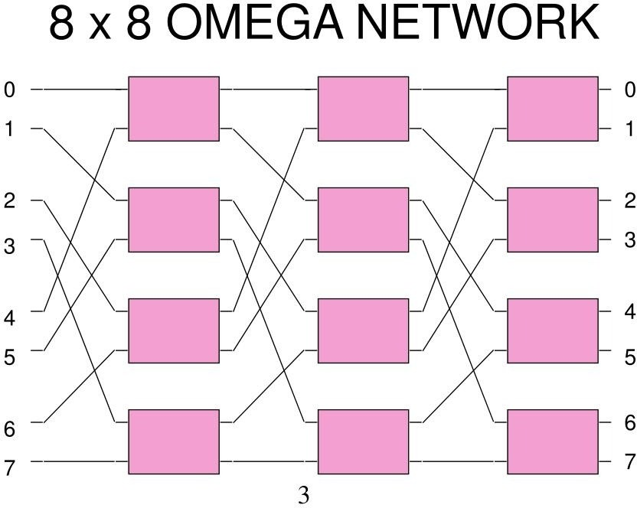

Slide 16
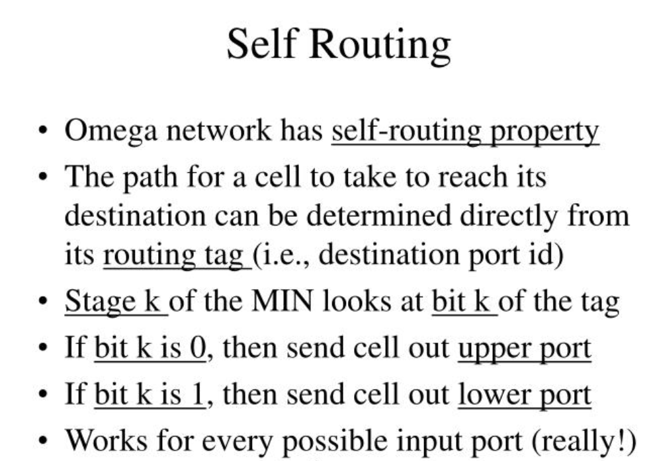

Slide 17
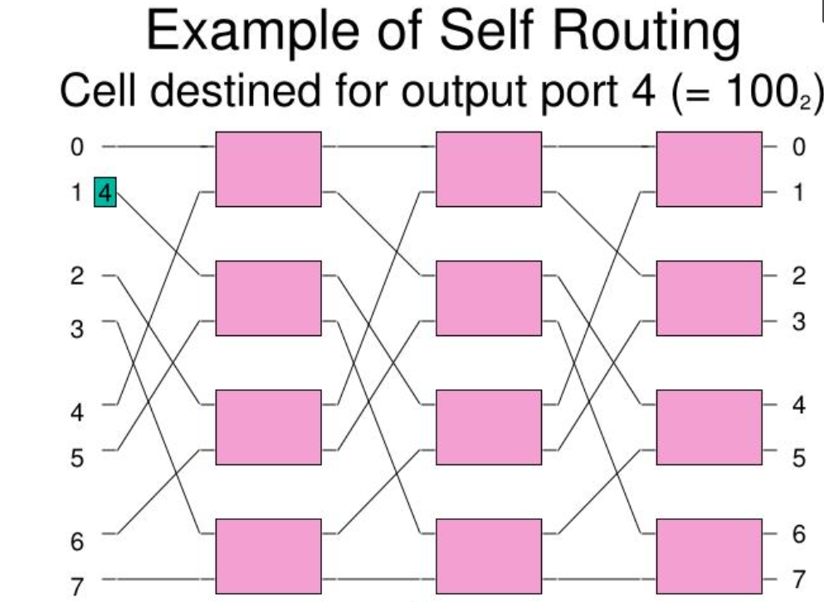
1 to 4

Slide 18
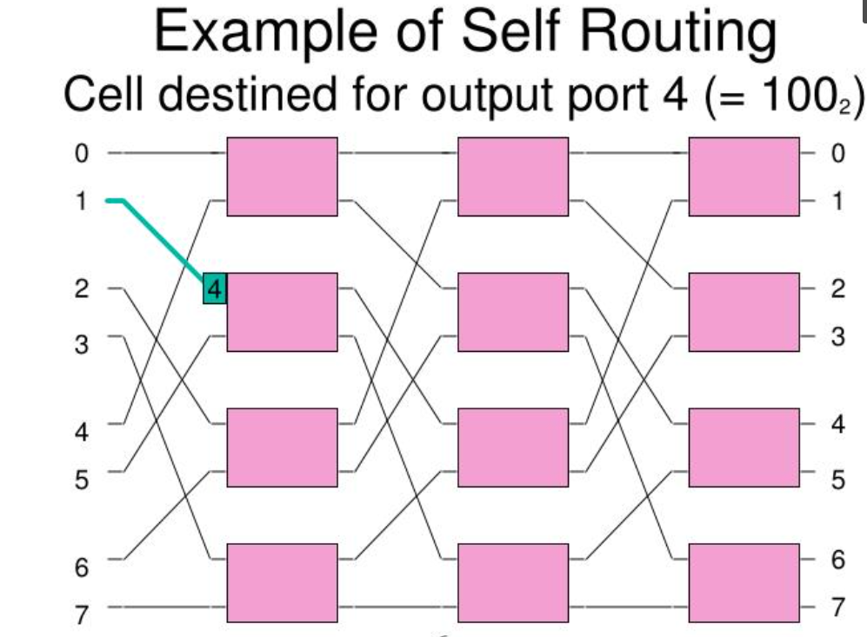

Slide 19
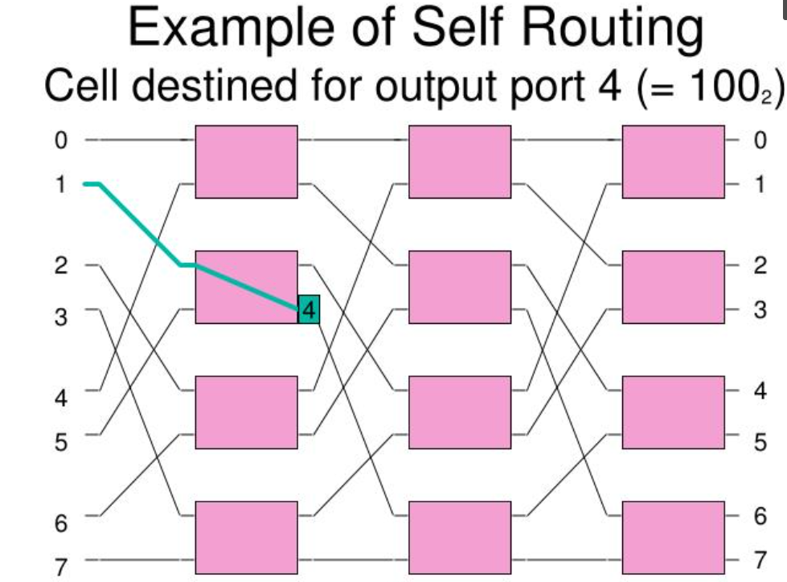

Slide 20
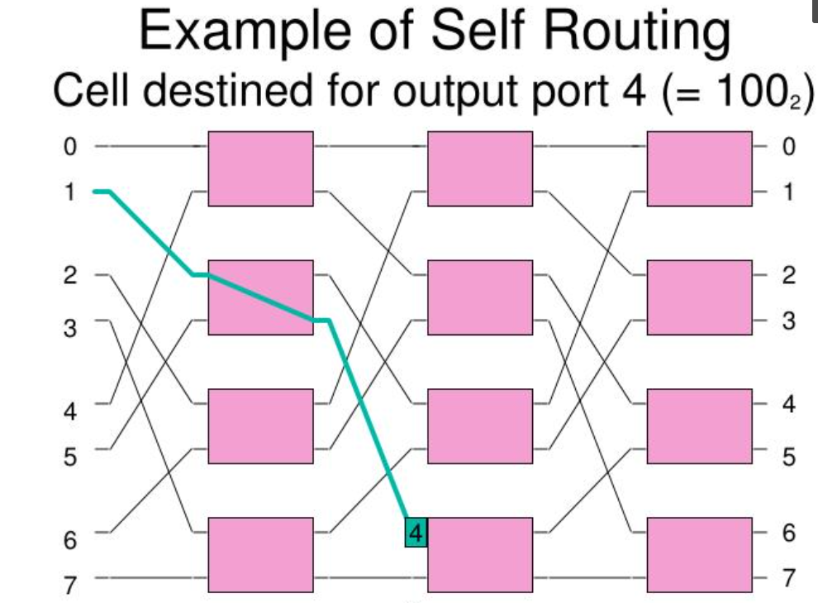

Slide 21
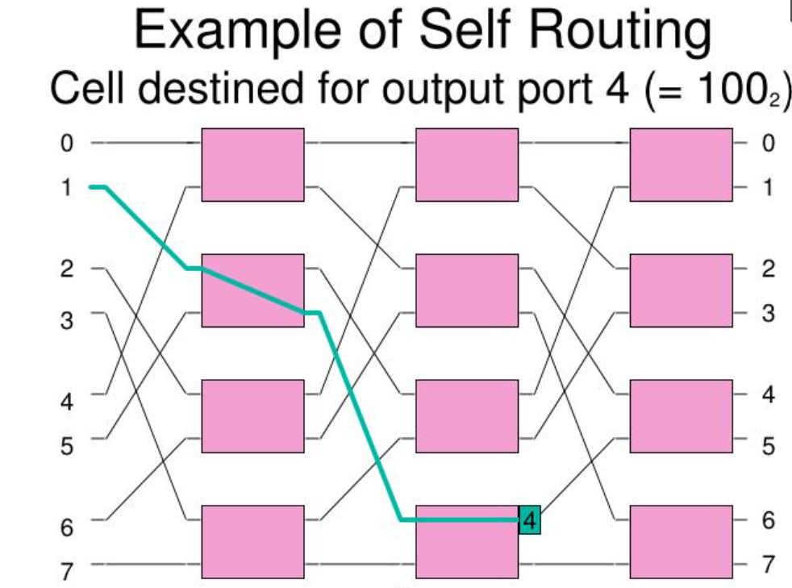

Slide 22
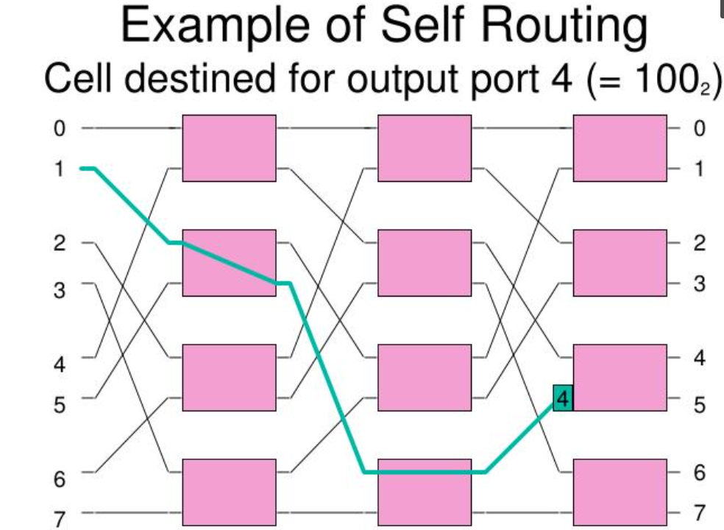

Slide 23
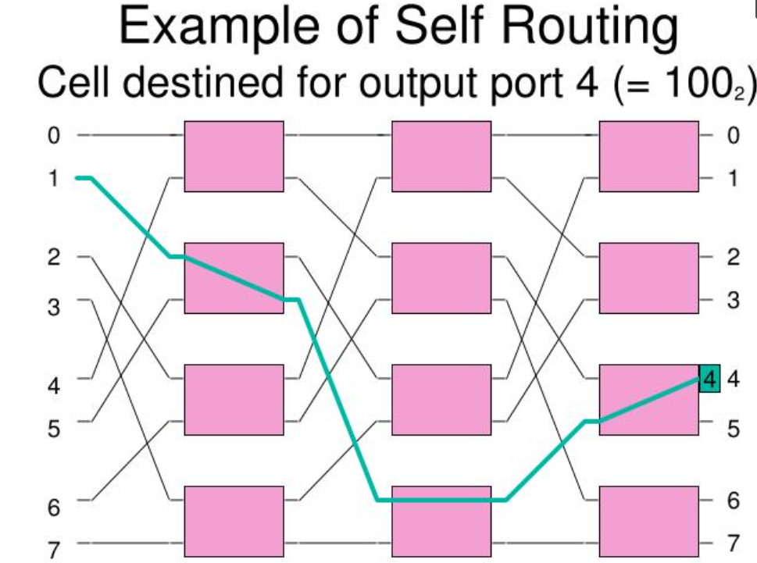

Slide 24
Butterfly Network

Slide 25
Essentials
Number of Nodes = (K+1)*2^K
Number of Ranks = K+1 (Starts from zero)
Network Diameter = 2*K
Bisection Width= 2^K
If K=3 Then
Number of Nodes = (3+1)*2^3 = 32
Number of Ranks = 3+1 = 4
Network Diameter = 2*3 = 6
Bisection Width= 2^3 = 8

Slide 26
Nodes and Ranks
Rank 0
Rank 1
Rank 2
Rank 3
000
001
010
011
100
101
110
111

Slide 27
Connections
Node (i,j) connected to Node (i-1,j) and (i-1,M) where i>0.
“i” is the Rank
“j” is the node
“M” is the inverted bit on ith location of j

Slide 28
Connections
Rank 0
Rank 1
Rank 2
Rank 3
000
001
010
011
100
101
110
111

Slide 29
Connection for j=000 where i=1
Rank 0
Rank 1
(i-1,j) = (1-1, 000) = (0,000)
(i-1,M) = (1-1, 0̅00) = (0,100)
Rank 2
Rank 3
010
011
100
101
110
111

Slide 30
Connection for j=001 where i=1
Rank 0
Rank 1
(i-1,j) = (1-1, 001) = (0,001)
(i-1,M) = (1-1, 0̅01) = (0,101)
Rank 2
Rank 3
010
011
100
101
110
111

Slide 31
Connection for j=010 where i=1
Rank 0
Rank 1
(i-1,j) = (1-1, 010) = (0,010)
(i-1,M) = (1-1, 0̅10) = (0,110)
Rank 2
Rank 3
010
011
100
101
110
111

Slide 32
Connection for j=011 where i=1
Rank 0
Rank 1
(i-1,j) = (1-1, 011) = (0,011)
(i-1,M) = (1-1, 0̅11) = (0,111)
Rank 2
Rank 3
010
011
100
101
110
111

Slide 33
Connection for j=100 where i=1
Rank 0
Rank 1
(i-1,j) = (1-1, 100) = (0,100)
(i-1,M) = (1-1, 1̅00) = (0,000)
Rank 2
Rank 3
010
011
100
101
110
111

Slide 34
Connection for j=101 where i=1
Rank 0
Rank 1
(i-1,j) = (1-1, 101) = (0,101)
(i-1,M) = (1-1, 1̅01) = (0,001)
Rank 2
Rank 3
010
011
100
101
110
111

Slide 35
Connection for j=110 where i=1
Rank 0
Rank 1
(i-1,j) = (1-1, 110) = (0,110)
(i-1,M) = (1-1, 1̅10) = (0,010)
Rank 2
Rank 3
010
011
100
101
110
111

Slide 36
Connection for j=111 where i=1
Rank 0
Rank 1
(i-1,j) = (1-1, 111) = (0,111)
(i-1,M) = (1-1, 1̅11) = (0,011)
Rank 2
Rank 3
010
011
100
101
110
111

Slide 37
Connection for j=000 where i=2
Rank 0
Rank 1
(i-1,j) = (2-1, 000) = (1,000)
(i-1,M) = (2-1, 00̅0) = (1,010)
Rank 2
Rank 3
010
011
100
101
110
111

Slide 38
Connection for j=001 where i=2
Rank 0
Rank 1
(i-1,j) = (2-1, 001) = (1,001)
(i-1,M) = (2-1, 00̅1) = (1,011)
Rank 2
Rank 3
010
011
100
101
110
111

Slide 39
Connection for j=010 where i=2
Rank 0
Rank 1
(i-1,j) = (2-1, 010) = (1,010)
(i-1,M) = (2-1, 01̅0) = (1,000)
Rank 2
Rank 3
010
011
100
101
110
111

Slide 40
Connection for j=011 where i=2
Rank 0
Rank 1
(i-1,j) = (2-1, 011) = (1,011)
(i-1,M) = (2-1, 01̅1) = (1,001)
Rank 2
Rank 3
010
011
100
101
110
111

Slide 41
Connection for j=100 where i=2
Rank 0
Rank 1
(i-1,j) = (2-1, 100) = (1,100)
(i-1,M) = (2-1, 10̅0) = (1,110)
Rank 2
Rank 3
010
011
100
101
110
111

Slide 42
Connection for j=101 where i=2
Rank 0
Rank 1
(i-1,j) = (2-1, 101) = (1,101)
(i-1,M) = (2-1, 10̅1) = (1,111)
Rank 2
Rank 3
010
011
100
101
110
111

Slide 43
Connection for j=110 where i=2
Rank 0
Rank 1
(i-1,j) = (2-1, 110) = (1,110)
(i-1,M) = (2-1, 11̅0) = (1,100)
Rank 2
Rank 3
010
011
100
101
110
111

Slide 44
Connection for j=110 where i=2
Rank 0
Rank 1
(i-1,j) = (2-1, 111) = (1,111)
(i-1,M) = (2-1, 11̅1) = (1,101)
Rank 2
Rank 3
010
011
100
101
110
111

Slide 45
Connection for j=000 where i=3
Rank 0
Rank 1
(i-1,j) = (3-1, 000) = (2,000)
(i-1,M) = (3-1, 000̅) = (2,001)
Rank 2
Rank 3
010
011
100
101
110
111

Slide 46
Connection for j=001 where i=3
Rank 0
Rank 1
(i-1,j) = (3-1, 001) = (2,001)
(i-1,M) = (3-1, 001̅) = (2,000)
Rank 2
Rank 3
010
011
100
101
110
111

Slide 47
Connection for j=010 where i=3
Rank 0
Rank 1
(i-1,j) = (3-1, 010) = (2,010)
(i-1,M) = (3-1, 010̅) = (2,011)
Rank 2
Rank 3
010
011
100
101
110
111

Slide 48
Connection for j=011 where i=3
Rank 0
Rank 1
(i-1,j) = (3-1, 011) = (2,011)
(i-1,M) = (3-1, 011̅) = (2,010)
Rank 2
Rank 3
010
011
100
101
110
111

Slide 49
Connection for j=100 where i=3
Rank 0
Rank 1
(i-1,j) = (3-1, 100) = (2,100)
(i-1,M) = (3-1, 100̅) = (2,101)
Rank 2
Rank 3
010
011
100
101
110
111

Slide 50
Connection for j=101 where i=3
Rank 0
Rank 1
(i-1,j) = (3-1, 101) = (2,101)
(i-1,M) = (3-1, 101̅) = (2,100)
Rank 2
Rank 3
010
011
100
101
110
111

Slide 51
Connection for j=110 where i=3
Rank 0
Rank 1
(i-1,j) = (3-1, 110) = (2,110)
(i-1,M) = (3-1, 110̅) = (2,111)
Rank 2
Rank 3
010
011
100
101
110
111

Slide 52
Connection for j=111 where i=3
Rank 0
Rank 1
(i-1,j) = (3-1, 111) = (2,111)
(i-1,M) = (3-1, 111̅) = (2,110)
Rank 2
Rank 3
010
011
100
101
110
111

Slide 53
Paths
To go node (0, j1) to (K, j2)
Take j2
If bit is 0 take left link
If bit is 1 take right link
If left or right is not possible take straight

Slide 54
Path between 000 and 111
Rank 0
Rank 1
J1 = 000 to j2 = 111
Rank 2
Rank 3
000
001
010
011
100
101
110
111

Slide 55
Path
Rank 0
Rank 1
J1 = 000 to j2 = 111
1st bit 1 take right
Rank 2
Rank 3
000
001
010
011
100
101
110
111

Slide 56
Path
Rank 0
Rank 1
J1 = 000 to j2 = 111
1st bit 1 take right 2nd bit 1 take right
Rank 2
Rank 3
000
001
010
011
100
101
110
111

Slide 57
Path
Rank 0
Rank 1
J1 = 000 to j2 = 111
1st bit 1 take right 2nd bit 1 take right 3rd bit 1 take right
Rank 2
Rank 3
000
001
010
011
100
101
110
111

Slide 58
Path
Rank 0
Rank 1
J1 = 001 to j2 = 110
1st bit 1 take right 2nd bit 1 take right 3rd bit 0 take left
Rank 2
Rank 3
000
001
010
011
100
101
110
111

Slide 59
Path
Rank 0
Rank 1
J1 = 010 to j2 = 101
1st bit 1 take right 2nd bit 0 take left 3rd bit 1 take right
Rank 2
Rank 3
000
001
010
011
100
101
110
111

Slide 60
Path
Rank 0
Rank 1
J1 = 011 to j2 = 100
1st bit 1 take right 2nd bit 0 take left 3rd bit 0 take left
Rank 2
Rank 3
000
001
010
011
100
101
110
111

Slide 61
Path
Rank 0
Rank 1
J1 = 100 to j2 = 000
1st bit 0 take left
2nd bit 0 take straight
3rd bit 0 take straight
Rank 2
Rank 3
000
001
010
011
100
101
110
111

Slide 62
Path
Rank 0
Rank 1
J1 = 101 to j2 = 011
1st bit 0 take left 2nd bit 1 take right
3rd bit 1 take straight
Rank 2
Rank 3
000
001
010
011
100
101
110
111

Slide 63
Flynn’s Taxonomy
Distributed Computing: Principles, Algorithms, and Systems
I
I I
I
I
C C C C C
I
C Control Unit P Processing Unit I instruction stream D data stream
I I I
P P P P
P P
D D
D D
D
(a) SIMD (b) MIMD (c) MISD
Figure 1.6: SIMD, MISD, and MIMD modes.
SISD: Single Instruction Stream Single Data Stream (traditional) SIMD: Single Instruction Stream Multiple Data Stream
⁾ scientific applicaitons, applications on large arrays
⁾ vector processors, systolic arrays, Pentium/SSE, DSP chips
MISD: Multiple Instruciton Stream Single Data Stream
⁾ E.g., visualization
MIMD: Multiple Instruction Stream Multiple Data Stream
⁾ distributed systems, vast majority of parallel systems
ting)
Introduction

Slide 64
Terminology
Distributed Computing: Principles, Algorithms, and Systems
Coupling
⁾ Interdependency/binding among modules, whether hardware or software (e.g., OS, middleware)
Parallelism: T (1)/T (n).
⁾ Function of program and system
Concurrency of a program
⁾ Measures productive CPU time vs. waiting for synchronization operations
Granularity of a program
⁾ Amt. of computation vs. amt. of communication
⁾ Fine-grained program suited for tightly-coupled system
ting)
Introduction

Slide 65
Message-passing vs. Shared Memory
Distributed Computing: Principles, Algorithms, and Systems
Emulating MP over SM:
⁾ Partition shared address space
⁾ Send/Receive emulated by writing/reading from special mailbox per pair of processes
Emulating SM over MP:
⁾ Model each shared object as a process
⁾ Write to shared object emulated by sending message to owner process for the object
⁾ Read from shared object emulated by sending query to owner of shared object
ting)
Introduction

Slide 66
1.6 Primitives for distributed communication
Blocking/non-blocking, synchronous/asynchronous primitives
Processor synchrony
Libraries and standards

Slide 67
Blocking/non-blocking, synchronous/asynchronous primitives
Message send and message receive communication primitives are denoted Send() and Receive() , respectively.
A Send primitive has at least two parameters – the destination, and the buffer in the user space, containing the data to be sent
Similarly, a Receive primitive has at least two parameters – the source from which the data is to be received (this could be a wildcard), and the user buffer into which the data is to be received.
There are two ways of sending data when the Send primitive is invoked –the buffered option and the unbuffered option
The buffered option which is the standard option copies the data from the user buffer to the kernel buffer. The data later gets copied from the kernel buffer onto the network.
In the unbuffered option, the data gets copied directly from the user buffer onto the network.
For the Receive primitive, the buffered option is usually required because the data may already have arrived when the primitive is invoked, and needs a storage place in the kernel.
destination | Buffer user space-data
Source | User buffer-data

Slide 68
The following are some definitions of blocking/non-blocking and synchronous/ asynchronous primitives :
• Synchronous primitives A Send or a Receive primitive is synchronous if both the Send() and Receive() handshake with each other. The processing for the Send primitive completes only after the invoking processor learns that the other corresponding Receive primitive has also been invoked and that the receive operation has been completed. The processing for the Receive primitive completes when the data to be received is copied into the receiver’s user buffer.
• Asynchronous primitives A Send primitive is said to be asynchronous if control returns back to the invoking process after the data item to be sent has been copied out of the user-specified buffer. It does not make sense to define asynchronous Receive primitives.
• Blocking primitives A primitive is blocking if control returns to the invoking process after the processing for the primitive (whether in synchronous or asynchronous mode) completes.
• Non-blocking primitives A primitive is non-blocking if control returns back to the invoking process immediately after invocation, even though the operation has not completed. For a non-blocking Send, control returns to the process even before the data is copied out of the user buffer. For a non-blocking Receive, control returns to the process even before the data may have arrived from the sender.

Slide 69
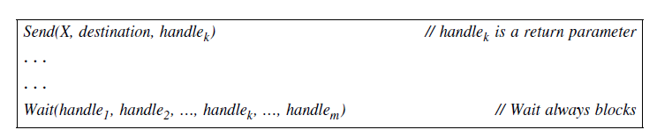
A non-blocking send primitive. When the Wait call returns, at least one of its parameters is posted.
Handle-status of completion
Check in 2 ways-
Keep checking handle-flaged
wait

Slide 70
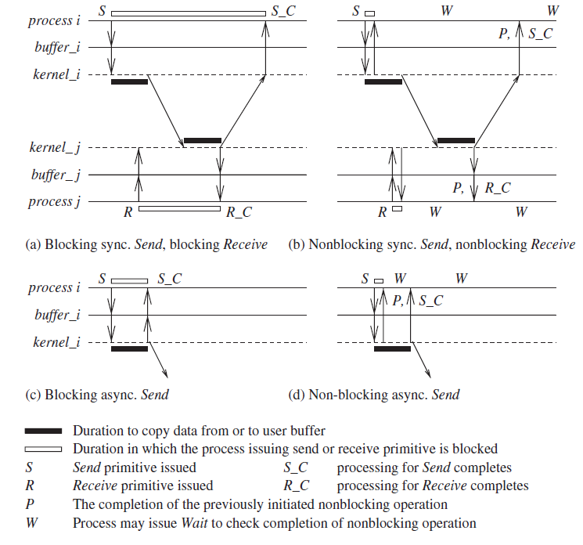

Slide 71
• Blocking synchronous Send (See Figure 1.8(a)) The data gets copied from the user buffer to the kernel buffer and is then sent over the network. After the data is copied to the receiver’s system buffer and a Receive call has been issued, an acknowledgement back to the sender causes control to return to the process that invoked the Send operation and completes the Send.
• non-blocking synchronous Send (See Figure 1.8(b)) Control returns back to the invoking process as soon as the copy of data from the user buffer to the kernel buffer is initiated. A parameter in the non-blocking call also gets set with the handle of a location that the user process can later check for the completion of the synchronous send operation. The location gets posted after an acknowledgement returns from the receiver, as per the semantics described for (a). The user process can keep checking for the completion of the non-blocking synchronous Send by testing the returned handle, or it can invoke the blocking Wait operation on the returned handle (Figure 1.8(b)).
• Blocking asynchronous Send (See Figure 1.8(c)) The user process that invokes the Send is blocked until the data is copied from the user’s buffer to the kernel buffer. (For the unbuffered option, the user process that invokes the Send is blocked until the data is copied from the user’s buffer to the network.)
• non-blocking asynchronous Send (See Figure 1.8(d)) The user process that invokes the Send is blocked until the transfer of the data from the user’s buffer to the kernel buffer is initiated. (For the unbuffered option, the user process that invokes the Send is blocked until the transfer of the data from the user’s buffer to the network is initiated.) Control returns to the user process as soon as this transfer is initiated, and a parameter in the non-blocking call also gets set with the handle of a location that the user process can check later using the Wait operation for the completion of the asynchronous Send operation. The asynchronous Send completes when the data has been copied out of the user’s buffer. The checking for the completion may be necessary if the user wants to reuse the buffer from which the data was sent.
• Blocking Receive (See Figure 1.8(a)) The Receive call blocks until the data expected arrives and is written in the specified user buffer. Then control is returned to the user process.
• non-blocking Receive (See Figure 1.8(b)) The Receive call will cause the kernel to register the call and return the handle of a location that the user process can later check for the completion of the non-blocking Receive operation. This location gets posted by the kernel after the expected data arrives and is copied to the user-specified buffer. The user process can

Slide 72
Processor synchrony
As opposed to the classification of synchronous and asynchronous communication
primitives, there is also the classification of synchronous versus asynchronous processors.
Processor synchrony indicates that all the processors execute in lock-step with their clocks synchronized.
As this synchrony is not attainable in a distributed system, what is more generally indicated is that for a large granularity of code, usually termed as a step, the processors are synchronized.
This abstraction is implemented using some form of barrier synchronization to ensure that no processor begins executing the next step of code until all the processors have completed executing the previous steps of code assigned to each of the processors.

Slide 73
Libraries and standards
some publicly available interfaces that embody some of the above concepts.
There exists a wide range of primitives for message-passing.
Many commercial software products (banking, payroll, etc., applications) use proprietary primitive libraries supplied with the software marketed by the vendors (e.g., the IBM CICS software which has a very widely installed customer base worldwide uses its own primitives).
The message-passing interface (MPI) library [20, 30]
the PVM (parallel virtual machine) library [31] are used largely by the scientific
community, but other alternative libraries exist.
Commercial software is often written using the remote procedure calls (RPC) mechanism [1, 6] in which procedures that potentially reside across the network are invoked transparently to the user, in the same manner that a local procedure is invoked [1, 6].
Under the covers, socket primitives or socket-like transport layer primitives are invoked to call the procedure remotely. There exist many implementations of RPC [1, 7, 11] – for example, Sun RPC, and distributed computing environment (DCE) RPC.
“Messaging” and “streaming” are two other mechanisms for communication. With the growth of object based software, libraries for remote method invocation (RMI) and remote object invocation (ROI) with their own set of primitives are being proposed and standardized by different agencies [7].
CORBA (common object request broker architecture) [36] and DCOM (distributed component object model) [7] are two other standardized architectures with their own set of primitives. Additionally, several projects in the research stage are designing their own flavour of communication primitives.

Slide 74
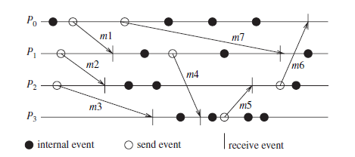
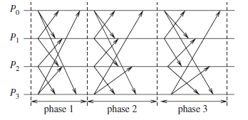
1.7 Synchronous versus asynchronous executions
In addition to the two classifications of processor synchrony/asynchrony and of synchronous/asynchronous communication primitives, there is another classification, namely that of synchronous/asynchronous executions.
• An asynchronous execution is an execution in which (i) there is no processor synchrony and there is no bound on the drift rate of processor clocks, (ii) message delays (transmission + propagation times) are finite but unbounded, and (iii) there is no upper bound on the time taken by a process to execute a step. An example asynchronous execution with four processes P0 to P3 is shown in Figure
The arrows denote the messages; the tail and head of an arrow mark the send and receive event for that message, denoted by a circle and vertical line, respectively. Non-communication events, also termed as internal events, are shown by shaded circles.
• A synchronous execution is an execution in which
(i) processors are synchronized and the clock drift rate between any two processors is bounded,
(ii) message delivery (transmission + delivery) times are such that they occur in one logical step or round, and
(iii) there is a known upper bound on the time taken by a process to execute a step. An example of a synchronous execution with four processes P0 to P3 is shown in Figure The arrows denote the messages

Slide 75
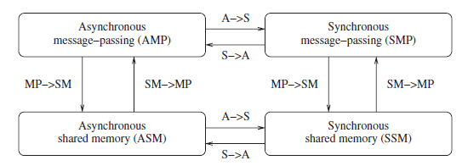
Synchronous versus asynchronous executions
Emulating an asynchronous system by a synchronous system (A→S)
An asynchronous program (written for an asynchronous system) can be emulated on a synchronous system fairly trivially as the synchronous system is a special case of an asynchronous system – all communication finishes within the same round in which it is initiated.
Emulating a synchronous system by an asynchronous system (S →A)
A synchronous program (written for a synchronous system) can be emulated on an asynchronous system using a tool called synchronizer.
Emulations
Section 1.5 showed how a shared memory system could be emulated by a message-passing system, and vice-versa. We now have four broad classes of programs, as shown in Figure 1.11. Using the emulations shown, any class can be emulated by any other. If system A can be emulated by system B, denoted A/B, and if a problem is not solvable in B, then it is also not solvable in A. Likewise, if a problem is solvable in A, it is also solvable in B. Hence, in a sense, all four classes are equivalent in terms of Computability” – what can and cannot be computed – in failure-free systems.

Slide 76
1.8 Design issues and challenges
Distributed systems challenges from a system perspective
Algorithmic challenges in distribute
Applications of distributed computing and newer challenges d computing

Slide 77
Distributed systems challenges from a system perspective
• Communication :RPC,ROI,MSG PASS,streamed
• Processes : mgmt. of client/server,code migration, design s/w
• Naming : naming cannot be tied to any static geo topology
• Synchronization : processes,clocks
• Data storage and access : fast and scalable
• Consistency and replication :bottleneck
• Fault tolerance : recovery from failure
• Security : cryptograpgy key,access contol
• Applications Programming Interface (API) and transparency:
access, location, migration,
relocation, replication,
concurrency, failure

Slide 78
Algorithmic challenges in distributed SYSTEMS
Designing useful execution models and frameworks
interleaving and partial order- operational reasoning ,design algo
Dynamic distributed graph algorithms and distributed routing algorithms
graphs are building blocks for communication, data dissemination, object search…
dynamically changing graphs – loads
efficiency – user perceived latency and traffic
Time and global state in a distributed system
physical time
logical time
global state- state gathering efforts

Slide 79
Synchronization/coordination mechanisms
physical clock
Leader election –asymmetry
Mutual exclusion
Deadlock detection and resolution- unnecessary abort process, avoid duplicate work
Terminating detection – global state of system
Garbage collection
Group communication, multicast, and ordered message delivery
Algo design
Order of receiving
Monitoring distributed events and predicates
Local –global debugging, sensing env, industrial process control
Event streaming – examined to detect predicates
Distributed program design and verification tools
Pgms – correct –reduce overhead – designing is challenging

Slide 80
Debugging distributed programs
Hard – sequential harder- distributed - concurrency
Data replication, consistency models, and caching
Fast access
Consistency
Placement – cannot freely replicated
World Wide Web design – caching, searching, scheduling
Prefetching-object replication and caching
Accessing- efficiently and accurately is challenging
Distributed shared memory abstraction
Wait free algorithm
Mutual exclusion
Register construction
Consistency models

Slide 81
Reliable and fault-tolerant distributed systems
Consensus algorithm –in case on malicious process
Replication and replica management – triple modular redundancy in case of failure
Voting – providing redundancy in process and resources
Distributed database and distributed commit - ACID
Self stabilizing system – bad to good
Checkpointing and recovery algorithm – periodically recording the good state
Failure detectors – sent but not yet received
Load balancing
Data migration –move data
Computation migration – relocate processes
Distributed scheduling – better turnaround time
Real time scheduling
No global view
Dynamic changes
Message propagation delay
Network dependent
Performance -
Metrics
Measurement methods/tools

Slide 82
Applications of distributed computing and newer challenges d computing
Sensor networks
Electro mechanical interface-physical parameters
Monitoring distributed systems – event streaming
Mobile systems -
Computer science perspective- routing, location management, channel allocation, management of mobility
Others – range, power of transmission, battery power conservation, interfacing with wired n/w, signal processing
Base station approach – cellular, communication
Adhoc n/w approach –mobile nodes –routers, complex
Ubiquitous or pervasive computing
Processors embedded in applications- intelligent home ,smart workplace
Peer-to-peer computing
Computing over application network layer – processors are equal- symmetric role
No central directories
Object storage mechanism, efficient object lookup, retrieval
Publish-subscribe, content distribution, and multimedia
Distributed agents – robots
-coordination , mobility design
Distributed data mining
Examine large data- mining –DB and AI to data repository- banking
Grid computing –cpu cycles
Security in distributed systems – confidentiality, authentication, availability

Slide 83
A Distributed Program
Distributed Computing: Principles, Algorithms, and Systems
A distributed program is composed of a set of n asynchronous processes, p₁, p₂, ..., p_{i} , ..., p_{n} .
The processes do not share a global memory and communicate solely by passing messages.
The processes do not share a global clock that is instantaneously accessible to these processes.
Process execution and message transfer are asynchronous.
Without loss of generality, we assume that each process is running on a different processor.
Let C_{ij} denote the channel from process p_{i} to process p_{j} and let m_{ij} denote a message sent by p_{i} to p_{j} .
The message transmission delay is finite and unpredictable.
CUP 2008
83 / 1

Slide 84
A Model of Distributed Executions
Distributed Computing: Principles, Algorithms, and Systems
The execution of a process consists of a sequential execution of its actions.
The actions are atomic and the actions of a process are modeled as three types of events, namely, internal events, message send events, and message receive events.
Let e^{x} denote the x th event at process p_{i} .
i
For a message m, let send (m) and rec (m) denote its send and receive events, respectively.
The occurrence of events changes the states of respective processes and channels.
An internal event changes the state of the process at which it occurs.
A send event changes the state of the process that sends the message and the state of the channel on which the message is sent.
A receive event changes the state of the process that receives the message and the state of the channel on which the message is received.
CUP 2008
84 / 1

Slide 85
A Model of Distributed Executions
Distributed Computing: Principles, Algorithms, and Systems
The events at a process are linearly ordered by their order of occurrence.
The execution of process p_{i} produces a sequence of events e¹, e², ..., e^{x} ,
i i i
e^{x+1}, ... and is denoted by H_{i} where
i
H_{i} = (h_{i} , →_{i} )
h_{i} is the set of events produced by p_{i} and
binary relation →_{i} defines a linear order on these events.
Relation →_{i} expresses causal dependencies among the events of p_{i} .
CUP 2008
85 / 1

Slide 86
A Model of Distributed Executions
Distributed Computing: Principles, Algorithms, and Systems
The send and the receive events signify the flow of information between processes and establish causal dependency from the sender process to the receiver process.
A relation →_{msg} that captures the causal dependency due to message exchange, is defined as follows. For every message m that is exchanged between two processes, we have
send (m) →_{msg} rec (m).
Relation →_{msg} defines causal dependencies between the pairs of corresponding send and receive events.
CUP 2008
86 / 1

Slide 87
A Model of Distributed Executions
Distributed Computing: Principles, Algorithms, and Systems
The evolution of a distributed execution is depicted by a space-time diagram.
A horizontal line represents the progress of the process; a dot indicates an event; a slant arrow indicates a message transfer.
Since we assume that an event execution is atomic (hence, indivisible and instantaneous), it is justified to denote it as a dot on a process line.
In the Figure 2.1, for process p₁, the second event is a message send event, the third event is an internal event, and the fourth event is a message receive event.
CUP 2008
87 / 1

Slide 88
A Model of Distributed Executions
Distributed Computing: Principles, Algorithms, and Systems
_{e}1
_{e}2
_{e}3
_{e}4 _{e}5
p
1
1
1
1
1
1
_{e}1
_{e}2
_{e}3
_{e}4
_{e}6
p
2
2
2
2
2
2
_{e}5
_{e}1
_{e}3
2
p
3
3
3
_{e}2
_{e}4
3
3
time
Figure 2.1: The space-time diagram of a distributed execution.
CUP 2008
88 / 1

Slide 89
A Model of Distributed Executions
Distributed Computing: Principles, Algorithms, and Systems
Causal Precedence Relation
The execution of a distributed application results in a set of distributed events produced by the processes.
Let H =∪_{i} h_{i} denote the set of events executed in a distributed computation.
Define a binary relation → on the set H as follows that expresses causal dependencies between events in the distributed execution.

e^{x} → e^{y} i .e., (i = j) ∧ (x < y )

i

i j

or
_{e}x
e^{x} →_{msg} e^{y}
∀e^{x} , ∀e^{y} ∈ H , → e^{y}
⇔
i j i j

i j

or

∃e^{z} ∈ H : e^{x} → e^{z} ∧ e^{z} → e^{y} k i k k j
The causal precedence relation induces an irreflexive partial order on the events of a distributed computation that is denoted as H=(H , →).
CUP 2008
89 / 1

Slide 90
A Model of Distributed Executions
Distributed Computing: Principles, Algorithms, and Systems
. . . Causal Precedence Relation
Note that the relation → is nothing but Lamport’s “happens before” relation.
For any two events e_{i} and e_{j} , if e_{i} → e_{j} , then event e_{j} is directly or transitively dependent on event e_{i} . (Graphically, it means that there exists a path consisting of message arrows and process-line segments (along increasing time) in the space-time diagram that starts at e_{i} and ends at e_{j} .)
For example, in Figure 2.1, e¹ → e³ and e³ → e⁶.
1 3 3 2
The relation → denotes flow of information in a distributed computation and e_{i} → e_{j} dictates that all the information available at e_{i} is potentially accessible at e_{j} .
For example, in Figure 2.1, event e⁶ has the knowledge of all other events
2
shown in the figure.
CUP 2008
90 / 1

Slide 91
A Model of Distributed Executions
Distributed Computing: Principles, Algorithms, and Systems
. . . Causal Precedence Relation
For any two events e_{i} and e_{j} , e_{i} /→ e_{j} denotes the fact that event e_{j} does not directly or transitively dependent on event e_{i} . That is, event e_{i} does not causally affect event e_{j} .
In this case, event e_{j} is not aware of the execution of e_{i} or any event executed after e_{i} on the same process.
For example, in Figure 2.1, e³ /→ e³ and e⁴ /→ e¹.
1 3 2 3
Note the following two rules:
For any two events e_{i} and e_{j} , e_{i} /→ e_{j} /⇒ e_{j} /→ e_{i} . For any two events e_{i} and e_{j} , e_{i} → e_{j} ⇒ e_{j} /→ e_{i} .
CUP 2008

Slide 92
A Model of Distributed Executions
Distributed Computing: Principles, Algorithms, and Systems
Concurrent events
For any two events e_{i} and e_{j} , if e_{i} /→ e_{j} and e_{j} /→ e_{i} ,
then events e_{i} and e_{j} are said to be concurrent (denoted as e_{i} ǁ e_{j} ).
In the execution of Figure 2.1, e³ ǁ e³ and e⁴ ǁ e¹.
1 3 2 3
The relation ǁ is not transitive; that is, (e_{i} ǁ e_{j} ) ∧ (e_{j} ǁ e_{k} ) /⇒ e_{i} ǁ e_{k} .
For example, in Figure 2.1, e³ ǁ e⁴ and e⁴ ǁ e⁵, however, e³ /ǁ e⁵.
3 2 2 1 3 1
For any two events e_{i} and e_{j} in a distributed execution,
e_{i} → e_{j} or e_{j} → e_{i} , or e_{i} ǁ e_{j} .
CUP 2008

Slide 93
A Model of Distributed Executions
Distributed Computing: Principles, Algorithms, and Systems
Logical vs. Physical Concurrency
In a distributed computation, two events are logically concurrent if and only if they do not causally affect each other.
Physical concurrency, on the other hand, has a connotation that the events occur at the same instant in physical time.
Two or more events may be logically concurrent even though they do not occur at the same instant in physical time.
However, if processor speed and message delays would have been different, the execution of these events could have very well coincided in physical time.
Whether a set of logically concurrent events coincide in the physical time or not, does not change the outcome of the computation.
Therefore, even though a set of logically concurrent events may not have occurred at the same instant in physical time, we can assume that these events occured at the same instant in physical time.
CUP 2008

Slide 94
Models of Communication Networks
Distributed Computing: Principles, Algorithms, and Systems
There are several models of the service provided by communication networks, namely, FIFO, Non-FIFO, and causal ordering.
In the FIFO model, each channel acts as a first-in first-out message queue and thus, message ordering is preserved by a channel.
In the non-FIFO model, a channel acts like a set in which the sender process adds messages and the receiver process removes messages from it in a random order.
CUP 2008

Slide 95
Models of Communication Networks
Distributed Computing: Principles, Algorithms, and Systems
The “causal ordering” model is based on Lamport’s “happens before” relation.
A system that supports the causal ordering model satisfies the following property:
CO: For any two messages m_{ij} and m_{kj} , if send (m_{ij} ) −→
send (m_{kj} ), then rec (m_{ij} ) −→ rec (m_{kj} ).
This property ensures that causally related messages destined to the same destination are delivered in an order that is consistent with their causality relation.
Causally ordered delivery of messages implies FIFO message delivery. (Note that CO ⊂ FIFO ⊂ Non-FIFO.)
Causal ordering model considerably simplifies the design of distributed algorithms because it provides a built-in synchronization.
CUP 2008

Slide 96
Global State of a Distributed System
Distributed Computing: Principles, Algorithms, and Systems
“A collection of the local states of its components, namely, the processes and the communication channels.”
The state of a process is defined by the contents of processor registers, stacks, local memory, etc. and depends on the local context of the distributed application.
The state of channel is given by the set of messages in transit in the channel.
The occurrence of events changes the states of respective processes and channels.
An internal event changes the state of the process at which it occurs.
A send event changes the state of the process that sends the message and the state of the channel on which the message is sent.
A receive event changes the state of the process that or receives the message and the state of the channel on which the message is received.
CUP 2008

Slide 97
. . . Global State of a Distributed System
Distributed Computing: Principles, Algorithms, and Systems
Notations
LS^{x} denotes the state of process p_{i} after the occurrence of event e^{x} and
i i
before the event e^{x+1}.
i
LS ⁰ denotes the initial state of process p_{i} .
i
LS^{x} is a result of the execution of all the events executed by process p_{i} till e^{x} .
i i
Let send (m)≤LS^{x} denote the fact that ∃y :1≤y ≤x :: e^{y} =send (m).
i i
Let rec (m)/≤LS^{x} denote the fact that ∀y :1≤y ≤x :: e^{y} /=rec (m).
i i
CUP 2008

Slide 98
. . . Global State of a Distributed System
Distributed Computing: Principles, Algorithms, and Systems
A Channel State
The state of a channel depends upon the states of the processes it connects.
Let SC^{x,y} denote the state of a channel C_{ij} .
ij
The state of a channel is defined as follows:
V
x,y
x
y
SC ={m | send (m ) ≤ e rec (m ) /≤ e }
ij ij ij
ij i j
Thus, channel state SC^{x,y} denotes all messages that p_{i} sent upto event e^{x} and
ij i
which process p_{j} had not received until event e^{y} .
j
CUP 2008

Slide 99
. . . Global State of a Distributed System
Distributed Computing: Principles, Algorithms, and Systems
Global State
The global state of a distributed system is a collection of the local states of the processes and the channels.
Notationally, global state GS is defined as,
S S
GS = { LS^{xi} ,
_{SC}y_{j} ,z_{k }}
i i j,k jk
For a global state to be meaningful, the states of all the components of the distributed system must be recorded at the same instant.
This will be possible if the local clocks at processes were perfectly synchronized or if there were a global system clock that can be instantaneously read by the processes. (However, both are impossible.)
CUP 2008

Slide 100
. . . Global State of a Distributed System
Distributed Computing: Principles, Algorithms, and Systems
A Consistent Global State
Even if the state of all the components is not recorded at the same instant, such a state will be meaningful provided every message that is recorded as received is also recorded as sent.
Basic idea is that a state should not violate causality – an effect should not be present without its cause. A message cannot be received if it was not sent.
Such states are called consistent global states and are meaningful global states.
Inconsistent global states are not meaningful in the sense that a distributed system can never be in an inconsistent state.
S S
A global state GS = { LS^{xi} , SC^{yj ,zk} } is a consistent global state iff
i i j,k jk
V
x x ,y
y
∀m : send (m ) /≤ LS ⇔ m /∈ SC
rec (m ) /≤ LS
j
ij ij
i ^{i j}
ij ij
i ij j
That is, channel state SC^{yi ,zk} and process state LS^{zk} must not include any
ij j _{x}
message that process p_{i} sent after executing event e_{i} ^{i} .
CUP 2008

Slide 101
. . . Global State of a Distributed System
Distributed Computing: Principles, Algorithms, and Systems
An Example
Consider the distributed execution of Figure 2.2.
Figure 2.2: The space-time diagram of a distributed execution.
_{e}1
_{e}2
_{e} 3
_{e} 4
p
1
1
1
1
1
_{e}1
m
_{e} 2
_{e}4
3
^{m} 21
12
e₂
2
p
2
2
2
_{e} 1
_{e} 2
_{e} 3
_{e} 4
_{e}5
p
3
3
3
3
3
3
_{e}1
_{e} 2
p ₄
4
4
time
CUP 2008

Slide 102
. . . Global State of a Distributed System
Distributed Computing: Principles, Algorithms, and Systems
In Figure 2.2:
A global state GS₁ = {LS ¹, LS ³, LS ³, LS ²} is inconsistent
1 2 3 4
because the state of p₂ has recorded the receipt of message m₁₂, however,
the state of p₁ has not recorded its send.
A global state GS₂ consisting of local states {LS ², LS ⁴, LS ⁴, LS ²}
1 2 3 4
is consistent; all the channels are empty except C₂₁ that
contains message m₂₁.
CUP 2008

Slide 103
Cuts of a Distributed Computation
Distributed Computing: Principles, Algorithms, and Systems
“In the space-time diagram of a distributed computation, a cut is a zigzag line joining one arbitrary point on each process line.”
A cut slices the space-time diagram, and thus the set of events in the distributed computation, into a PAST and a FUTURE.
The PAST contains all the events to the left of the cut and the FUTURE contains all the events to the right of the cut.
For a cut C , let PAST(C ) and FUTURE(C ) denote the set of events in the PAST and FUTURE of C , respectively.
Every cut corresponds to a global state and every global state can be graphically represented as a cut in the computation’s space-time diagram.
Cuts in a space-time diagram provide a powerful graphical aid in representing and reasoning about global states of a computation.
CUP 2008

Slide 104
. . . Cuts of a Distributed Computation
Distributed Computing: Principles, Algorithms, and Systems
Figure 2.3: Illustration of cuts in a distributed execution.
C₁
C₂
1
2
_{e} 3
_{e} 4
e₁
e₁
p
1
1
1
_{e}1
_{e} 2
_{e} 3
_{e}4
p
2
2
2
2
2
_{e} 1
_{e} 2
_{e} 3
_{e} 4
_{e}5
p
3
3
3
3
3
3
_{e}1
_{e} 2
p ₄
4
4
time
CUP 2008

Slide 105
. . . Cuts of a Distributed Computation
Distributed Computing: Principles, Algorithms, and Systems
In a consistent cut, every message received in the PAST of the cut was sent in the PAST of that cut. (In Figure 2.3, cut C₂ is a consistent cut.)
All messages that cross the cut from the PAST to the FUTURE are in transit in the corresponding consistent global state.
A cut is inconsistent if a message crosses the cut from the FUTURE to the PAST. (In Figure 2.3, cut C₁ is an inconsistent cut.)
CUP 2008

Slide 106
Past and Future Cones of an Event
Distributed Computing: Principles, Algorithms, and Systems
Past Cone of an Event
An event e_{j} could have been affected only by all events e_{i} such that e_{i} → e_{j} .
In this situtaion, all the information available at e_{i} could be made accessible at e_{j} .
All such events e_{i} belong to the past of e_{j} .
Let Past(e_{j} ) denote all events in the past of e_{j} in a computation (H , →). Then,
Past(e_{j} ) = {e_{i} |∀e_{i} ∈ H , e_{i} → e_{j} }.
Figure 2.4 (next slide) shows the past of an event e_{j} .
CUP 2008

Slide 107
. . . Past and Future Cones of an Event
Distributed Computing: Principles, Algorithms, and Systems
Figure 2.4: Illustration of past and future cones.
max(Past_{i} (e_{j} ))
min(Future_{i} (e_{j} ))
PAST(e_{j} )
FUTURE( e_{j} )
e
j
CUP 2008

Slide 108
. . . Past and Future Cones of an Event
Distributed Computing: Principles, Algorithms, and Systems
Let Past_{i} (e_{j} ) be the set of all those events of Past(e_{j} ) that are on process p_{i} .
Past_{i} (e_{j} ) is a totally ordered set, ordered by the relation →_{i} , whose maximal element is denoted by max (Past_{i} (e_{j} )).
max (Past_{i} (e_{j} )) is the latest event at process p_{i} that affected event e_{j} (Figure 2.4).
CUP 2008

Slide 109
. . . Past and Future Cones of an Event
Distributed Computing: Principles, Algorithms, and Systems
S
Let Max Past(e_{j} ) = _{(∀i )}{max (Past_{i} (e_{j} ))}.
Max Past(e_{j} ) consists of the latest event at every process that affected event
e_{j} and is referred to as the surface of the past cone of e_{j} .
Past(e_{j} ) represents all events on the past light cone that affect e_{j} .
Future Cone of an Event
The future of an event e_{j} , denoted by Future(e_{j} ), contains all events e_{i} that are causally affected by e_{j} (see Figure 2.4).
In a computation (H , →), Future(e_{j} ) is defined as:
Future(e_{j} ) = {e_{i} |∀e_{i} ∈ H , e_{j} → e_{i} }.
CUP 2008

Slide 110
. . . Past and Future Cones of an Event
Distributed Computing: Principles, Algorithms, and Systems
Define Future_{i} (e_{j} ) as the set of those events of Future(e_{j} ) that are on process
p_{i} .
define min(Future_{i} (e_{j} )) as the first event on process p_{i} that is affected by e_{j} .
S
Define Min Future(e_{j} ) as _{(∀i )}{min(Future_{i} (e_{j} ))}, which consists of the first
event at every process that is causally affected by event e_{j} .
Min Future(e_{j} ) is referred to as the surface of the future cone of e_{j} .
All events at a process p_{i} that occurred after max (Past_{i} (e_{j} )) but before
min(Future_{i} (e_{j} )) are concurrent with e_{j} .
Therefore, all and only those events of computation H that belong to the set “H − Past(e_{j} ) − Future(e_{j} )” are concurrent with event e_{j} .
CUP 2008

Slide 111
Models of Process Communications
Distributed Computing: Principles, Algorithms, and Systems
There are two basic models of process communications – synchronous and asynchronous.
The synchronous communication model is a blocking type where on a message send, the sender process blocks until the message has been received by the receiver process.
The sender process resumes execution only after it learns that the receiver process has accepted the message.
Thus, the sender and the receiver processes must synchronize to exchange a message. On the other hand,
asynchronous communication model is a non-blocking type where the sender and the receiver do not synchronize to exchange a message.
After having sent a message, the sender process does not wait for the message to be delivered to the receiver process.
The message is bufferred by the system and is delivered to the receiver process when it is ready to accept the message.
CUP 2008

Slide 112
. . . Models of Process Communications
Distributed Computing: Principles, Algorithms, and Systems
Neither of the communication models is superior to the other.
Asynchronous communication provides higher parallelism because the sender process can execute while the message is in transit to the receiver.
However, A buffer overflow may occur if a process sends a large number of messages in a burst to another process.
Thus, an implementation of asynchronous communication requires more complex buffer management.
In addition, due to higher degree of parallelism and non-determinism, it is much more difficult to design, verify, and implement distributed algorithms for asynchronous communications.
Synchronous communication is simpler to handle and implement.
However, due to frequent blocking, it is likely to have poor performance and is likely to be more prone to deadlocks.
CUP 2008

Slide 113
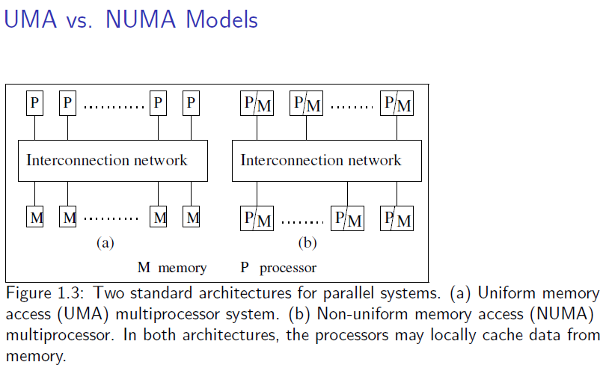

Slide 114
Interconnection Networks
Common Highway or interconnection network for processors in parallel to communicate.
Based on a topology interconnection network is built
Topology can be
Fixed
Reconfigurable(multistage interconnection network)

Slide 115
Omega Network
Multistage switching network has self routing property.
Multistage omega network used as connectors between CPUs and their shared memory, in order to decrease the probability of CPU-to –memory connection bottleneck.
Outputs of each stages are connected to inputs of next stage using a perfect shuffle connection system

Slide 116
8x8 Omega Network (logical left shift)
000->000->000->000
001->010->100->001
010->100->001->010
011->110->101->011
100->001->010->100
101->011->110->101
110->101->011->110
111->111->111->111
Input | Output
0 | 0
1 | 2
2 | 4
3 | 6
4 | 1
5 | 3
6 | 5
7 | 7

Slide 117
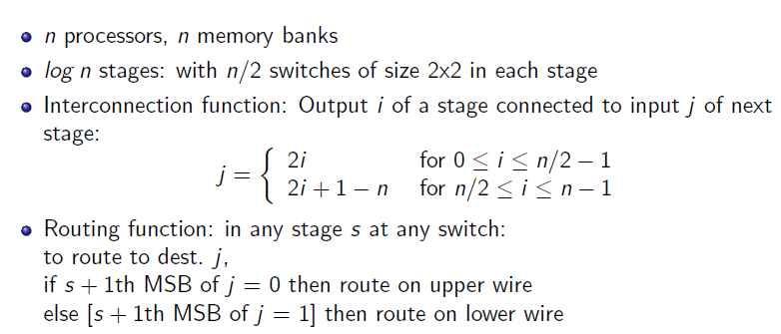
Omega Network

Slide 118
Omega Network using Routing function
Building 8X8 Omega Network using Routing Function

